Slide 1
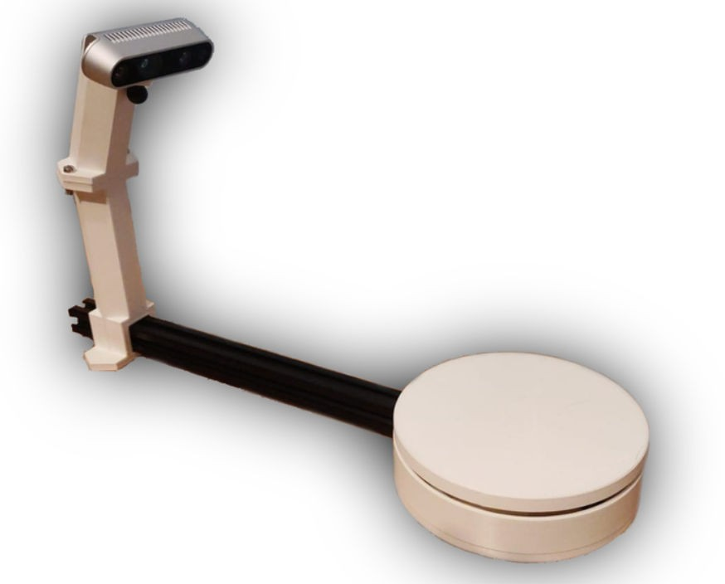
3D OBJECT SCANNING WITH THE INTEL DEPTH CAMERA D435IF
By: Dinesh Kumar R
B.Tech ECE

Slide 2
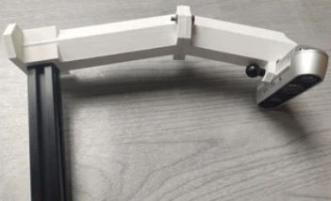
INTRODUCTION TO 3D SCANNING
Intel RealSense Depth Camera (e.g., D415, D435, D455) - This camera is equipped with depth-sensing technology that captures the distance between the camera and objects, providing 3D data for creating point clouds and meshes.
3D Object Scanning is revolutionizing how we capture and interact with the physical world. The Intel Depth Camera D435if combines advanced technology to provide high-quality depth data. This presentation explores its applications, beneﬁts, and future potential in various ﬁelds.

Slide 3

OBJECTIVE
This project focuses on using an Intel RealSense depth camera to scan physical objects and convert the captured data into 3D mesh ﬁles.
Mesh ﬁles are widely used in 3D modeling, printing, and virtual reality. By following this workﬂow, you can capture real-world objects and create digital 3D models suitable for use in applications that require realistic representations.

Slide 4
REQUIRED COMPONENTS
I ntel Real Sense Depth Camera (e.g., D415, D435, D455) - This camera is equipped with depth-sensing technology that captures the distance between the camera and objects, providing 3D data for creating point clouds and meshes. In My Case Used Intel Depth Camera D435if
3d printer is needed for making turning table And Mount for 3D Object Scanner

Slide 5
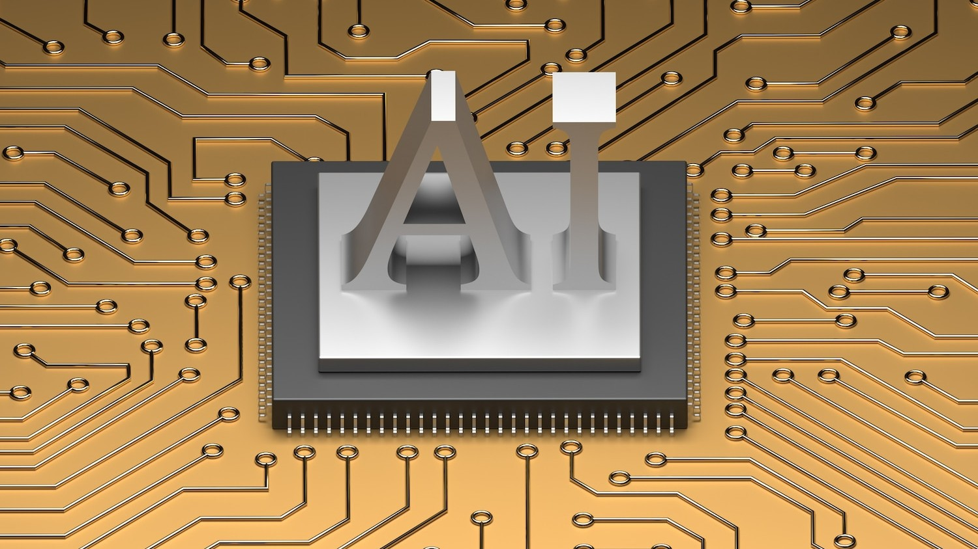
HOW THE D435if WORKS
The Intel Depth Camera D435if utilizes stereo vision technology to capture depth information.
It features dual RGB and infrared sensors that work together to produce accurate 3D models.
This enables precise measurements and enhances the scanning experience.

Slide 6

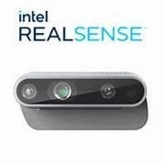
SOFTWARE LIBRARIES:
Intel RealSense SDK: Used for capturing depth frames from the RealSense camera.
Open3D: A powerful library for working with 3D data, including point cloud generation and mesh reconstruction.
Point Cloud Library (PCL): Optional, provides additional tools for point cloud processing, Sample pcl is given below as ply ﬁle in the image

Slide 7
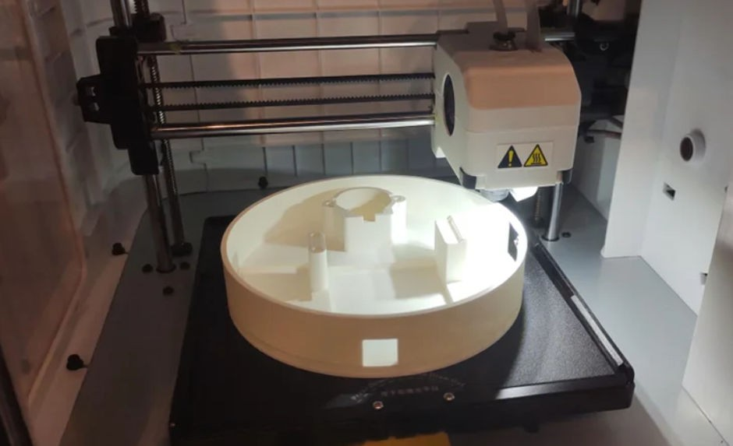
APPLICATIONS
3D Printing: Scan objects to create printable 3D models.
Virtual Reality: Import meshes into VR environments for realistic simulations.
Digital Archives: Preserve real-world artifacts digitally for educational or archival purposes

Slide 8
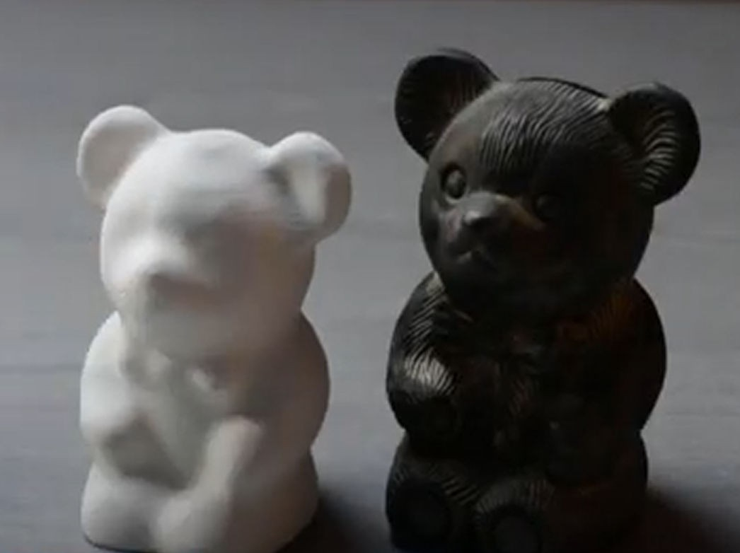
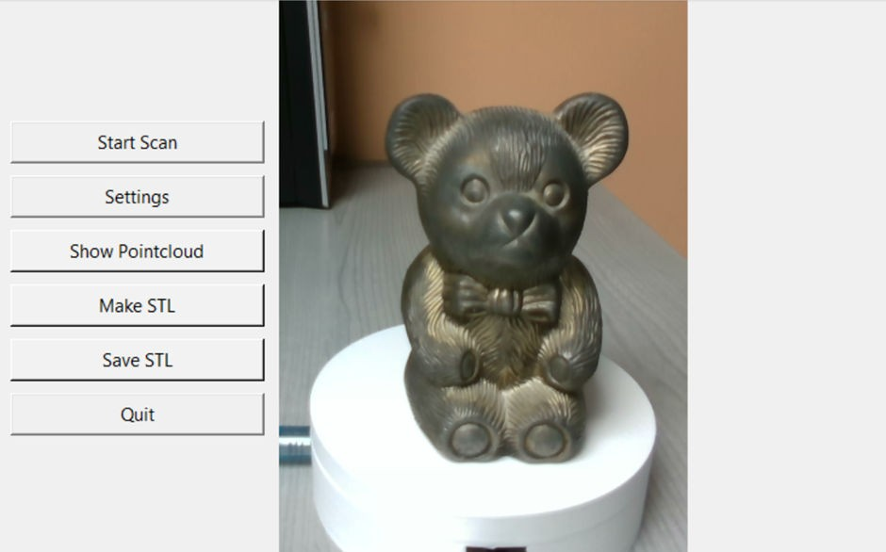
IMPLEMENTATION
First Image is the Output of 3D Object Scanner Constructed 3D Printer
second Image is the GUI of the python code Created by the Package tkinter

Slide 9
CONCLUSION
This 3D scanning workﬂow enables the transformation of real- world objects into digital mesh ﬁles using the Intel Real Sense depth camera.
The ﬁnal mesh ﬁles can be imported into 3D modeling or CAD software for further reﬁnement, enabling applications in 3D printing, VR/AR, and digital art.

Slide 10
Thank You!

